Slide 1
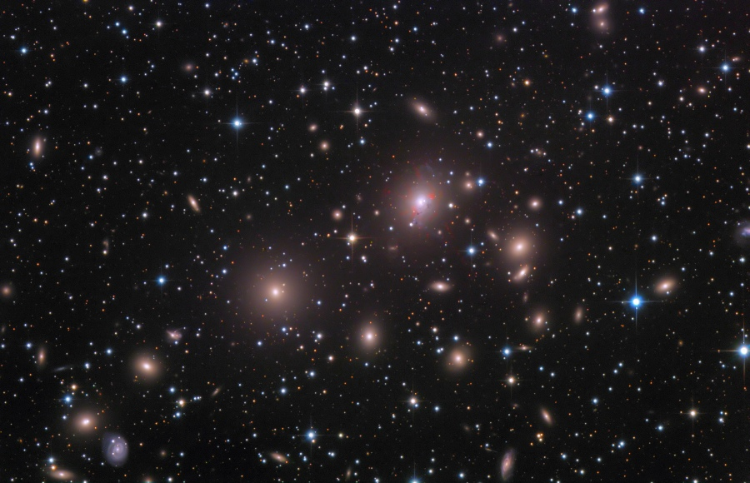

Galaxy clusters and groups
• Introduction
• The local group
• Galaxy clusters
• X-rays from clusters
• Evolution of clusters

Slide 2
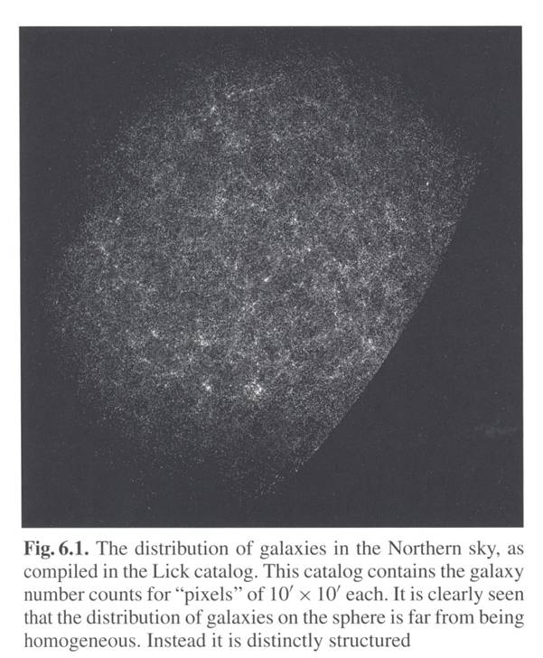
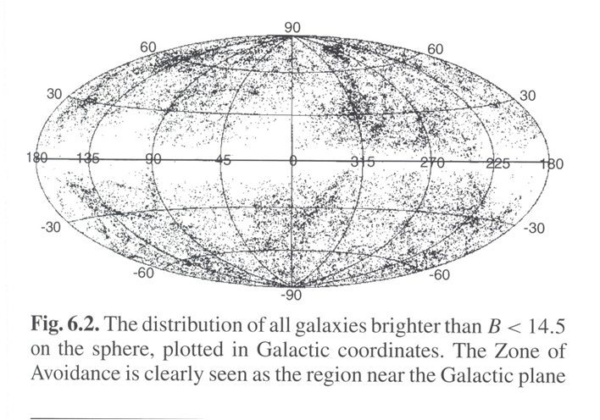
Introduction
Space distribution of galaxies non homogeneous

Slide 3
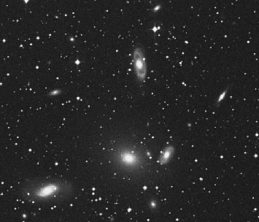
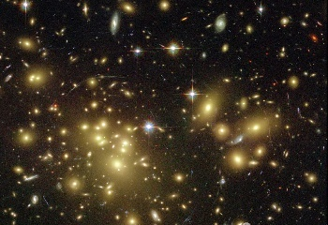
Introduction - 2
• Cluster: concentration of more than ~50 galaxies
diameter > ~1.5 Mpc/h
mass > ~3·10¹⁴ M_{O}
• Groups: smaller concentrations
mass ~3·10¹³ M_{O}

Slide 4
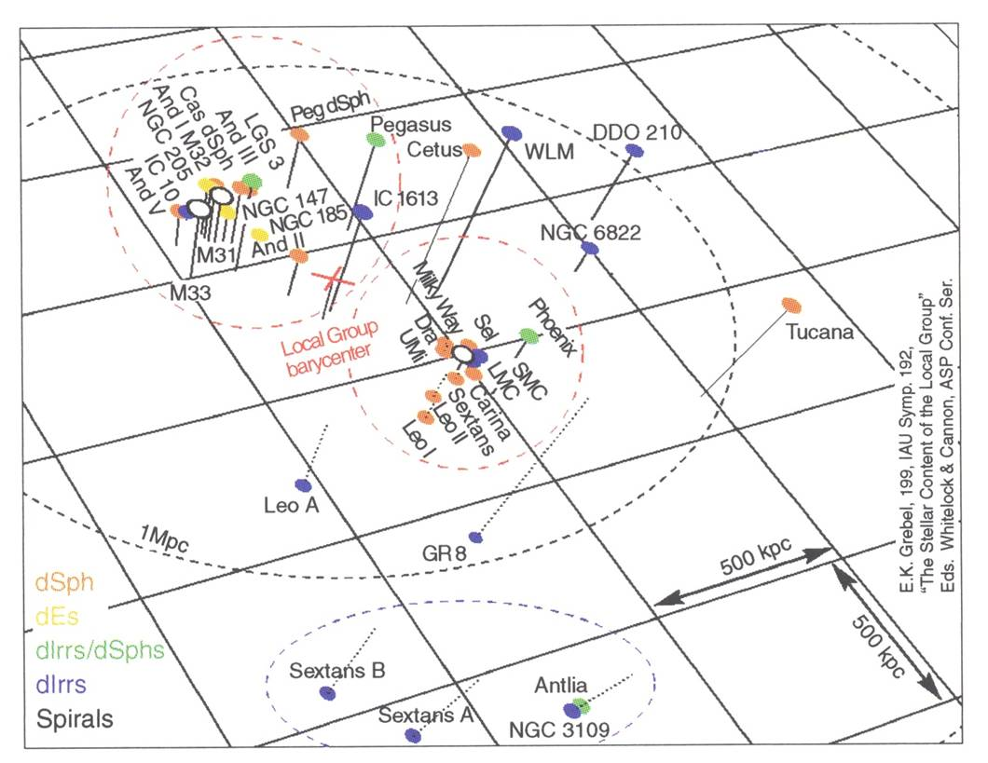
The local group

Slide 5
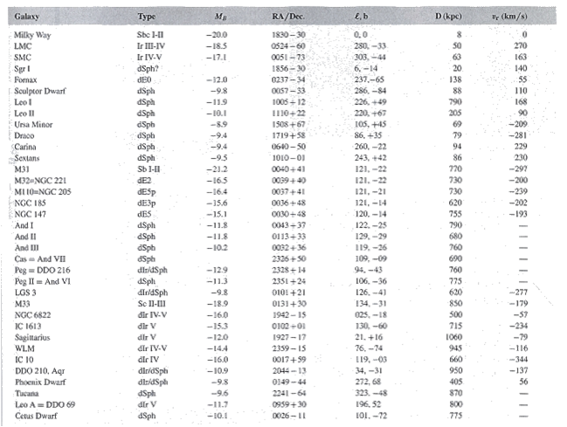
The local group - 2

Slide 6
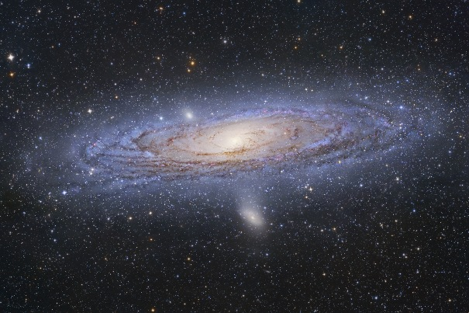
The local group - 3
M 31 – M 32 – NGC 205

Slide 7
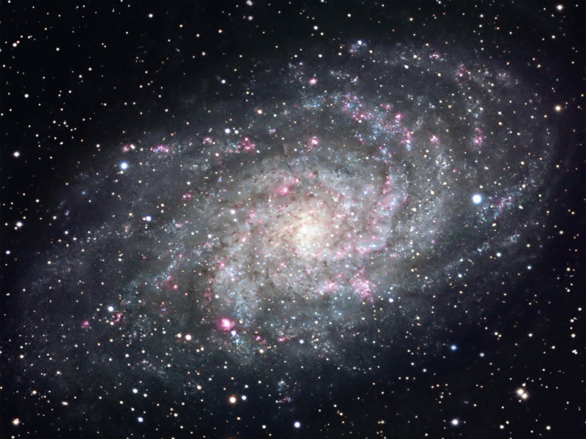
The local group - 4
M 33

Slide 8
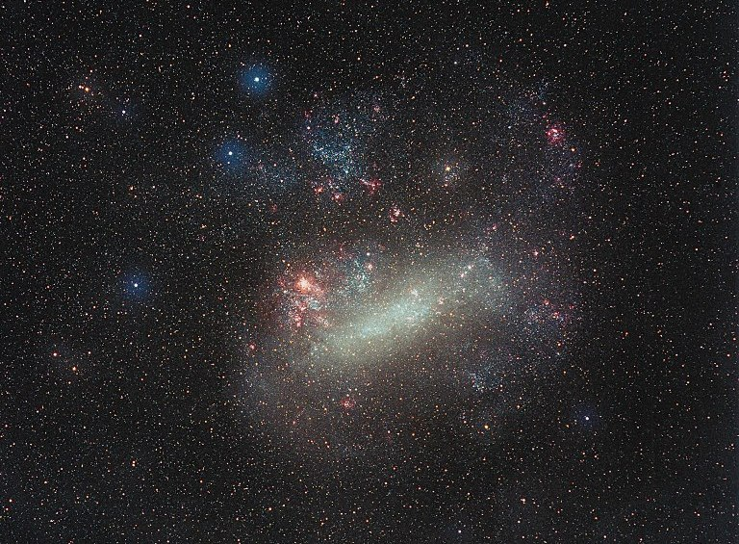
The local group - 5
The Large Magellanic Cloud (LMC)

Slide 9
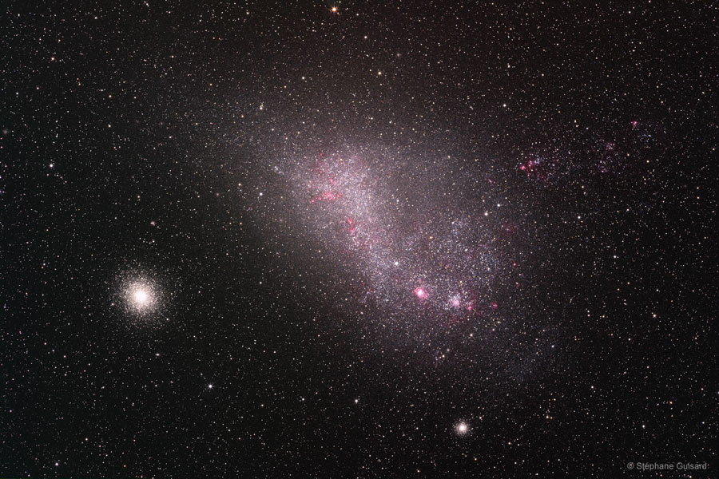
The local group - 6
The Small Magellanic Cloud (SMC)

Slide 10
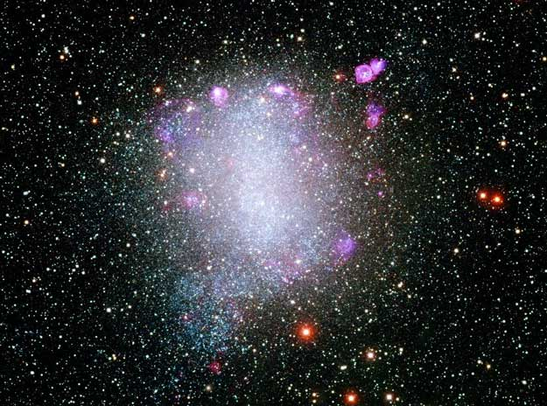
The local group - 7
NGC 6822

Slide 11
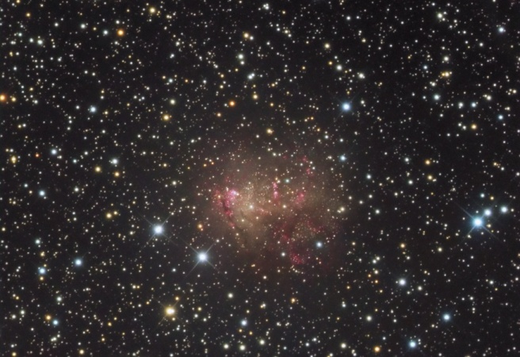
The local group - 8
IC 10

Slide 12
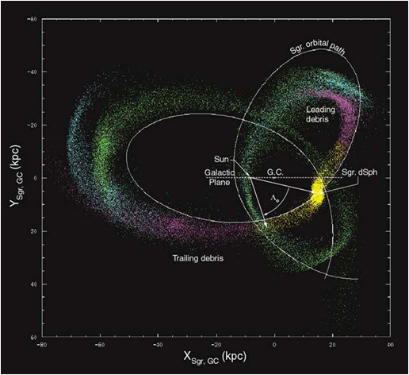
The local group - 9
The Sagittarius dwarf:
• in the direction of the galactic center, very low surface brightness, detected from the analysis of stars kinematics, different from bulge stars
• nearby (20 kpc), undergoes strong tidal forces from our Galaxy, tearing stars out, that are found along the trajectory of the dwarf galaxy

Slide 13
Galaxy clusters
• cluster ↔ overdensity of galaxies in a given solid angle
• if one orders galaxies from the brightest to the faintest one → m_{k} = magnitude of the k^{th} brightest cluster galaxy
Abell criterion (1958)
A cluster of galaxies is a concentration of:
– more than 50 galaxies with magnitude m: m₃ < m < m₃+2
– in a circle of angular radius θ_{a} < 1΄.7/z
(in the Abell catalogue, z is estimated from m₁₀, assumed identical in all clusters)

Slide 14
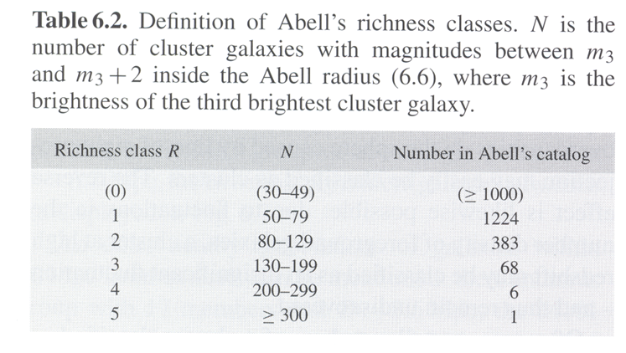
Galaxy clusters - 2
Abell catalogue
• built from visual inspection of photographic plates
• covers 2/3 of the sky
• z < 0.2

Slide 15
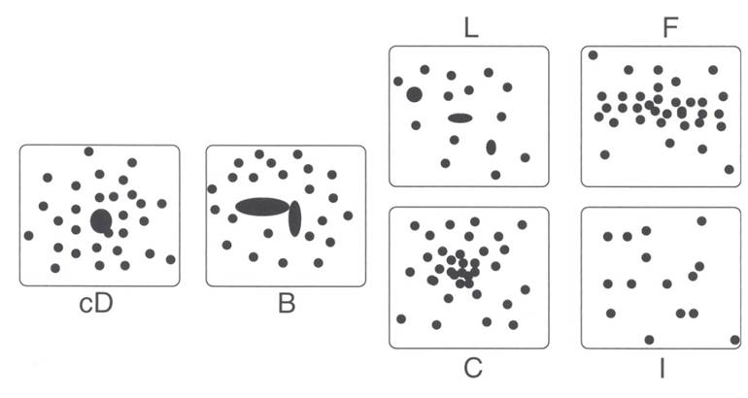
Galaxy clusters - 3
Morphological classification
cD: cD galaxy in the center B: 2 bright galaxies in center L: alignment of dominant galaxies F: oblate shape without dominant galaxy C: nucleus with >4 bright gal. I: irregular
évolution
• regular clusters: more compact, more ellipticals, higher central density (→ evolved clusters)
• irregular clusters: more open, more spirals, less dense (→ clusters in formation process)

Slide 16
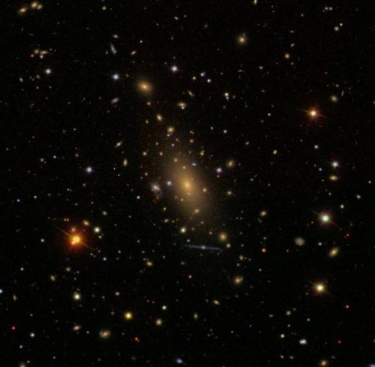
Galaxy clusters - 4
Abell 2029 – cD

Slide 17
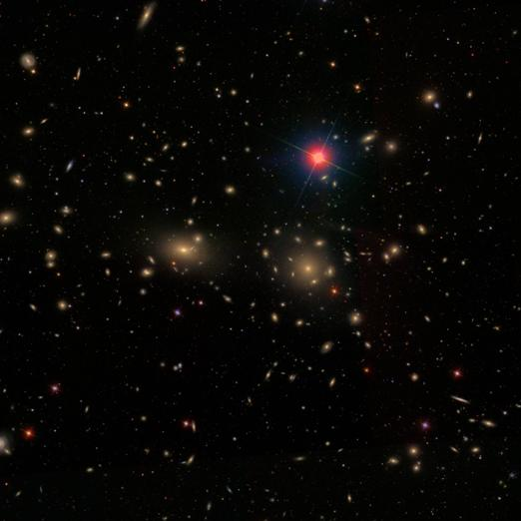
Galaxy clusters - 5
Coma – B

Slide 18
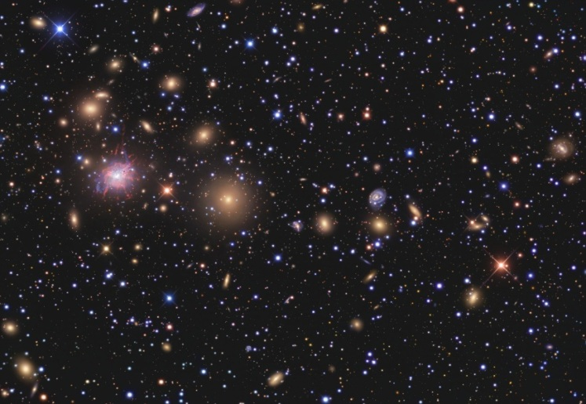
Galaxy clusters - 6
Perseus – L

Slide 19
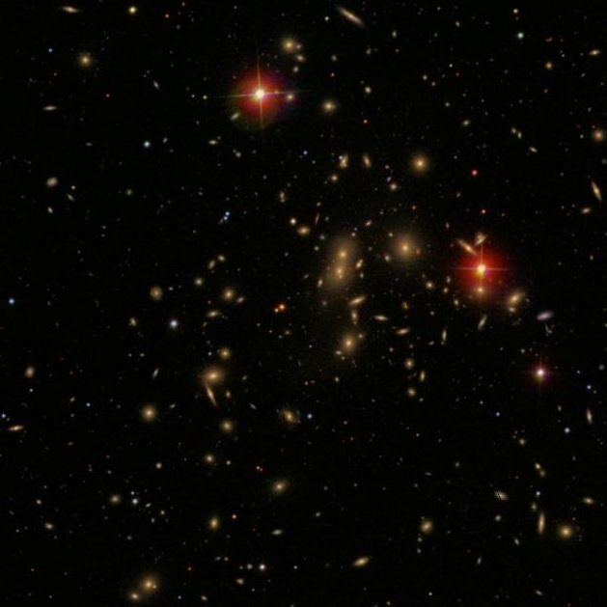
Galaxy clusters - 7
Abell 2065 – C

Slide 20
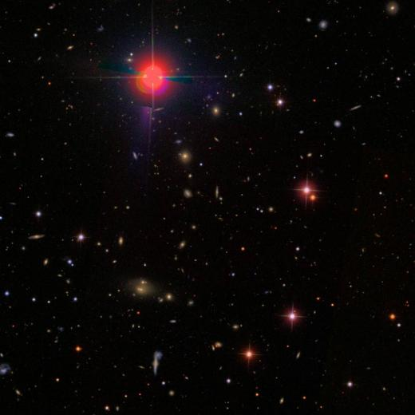
Galaxy clusters - 8
Abell 1291 – F

Slide 21
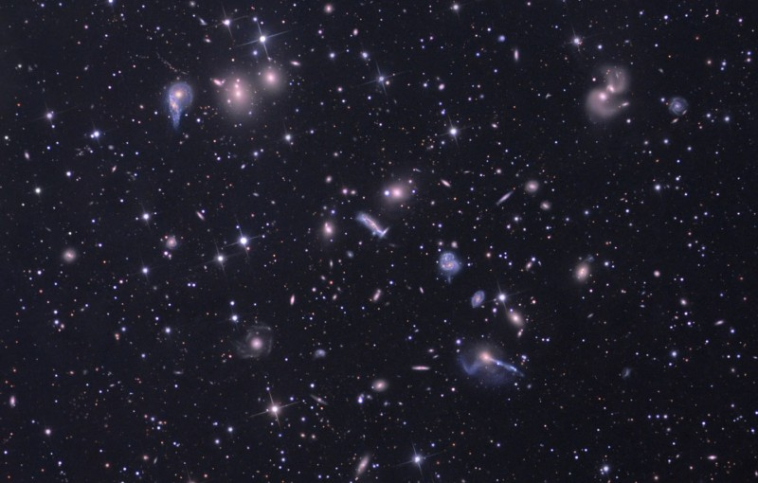
Galaxy clusters - 9
Hercules – I

Slide 22
Galaxy clusters - 10
Cluster dynamics
• Dynamic mass
For an isolated system in dynamical equilibrium:
R = characteristic distance between 2 galaxies ~ cluster radius
σ = velocity dispersion (deduced from radial velocities by assuming some spatial distribution)
With R ~ 3 Mpc and σ ~ 1000 km/s → M ~ 10¹⁵ M_{O}
→ mass cluster >> sum of masses of galaxies (even taking into account their dark matter halos)

Slide 23
Galaxy clusters - 11
• Crossing time
For a cluster of size R and galaxies velocity dispersion σ:
t_{cross} ~ R/σ (*)
R ~ 1 – 10 Mpc et σ ~ 1000 km/s → t_{cross} ~ 1 – 10 Gyr
→ galaxies just had time to complete one or a few orbits
(*) with R in Mpc and σ in 1000 km/s, one gets t in billion years

Slide 24
Galaxy clusters - 12
• Relaxation time
(1) Time such that 2-body collisions
– establish equipartition of energy
– make the velocity distribution isotropic
For a cluster containing N galaxies:
With N ~ 100 – 1000 and t_{cross} ~ 1 – 10 Gyr → t_{2–body} ~ 4 – 200 Gyr
(2) relaxation time taking into account a diffuse component (gas and/or dark matter):
: f_{gal} = fraction of the cluster mass that is in galaxies
→ t_{relax} > age of the Universe

Slide 25
Galaxy clusters - 13
→ relaxation by collisions not significant (unless, possibly, for compact sub-groups at the cluster center)
Consequence of relaxation by collisions:
– equipartition of energy
→ the most massive galaxies should be found close to the center
– which is what is generally observed
– but this is explained by dynamical friction and merging…

Slide 26
Galaxy clusters - 14
• Violent relaxation
To explain the regular shape of elliptical galaxies while 2-body collisions are negligible, Donald Lynden-Bell introduces in 1967 a statistical formulation for a collisionless gas in equilibrium under its own gravity
→ he called that phenomenon violent relaxation
Its characteristic time is
The same argument can be applied to clusters
→ they still need at least a few billion years to relax
→ most clusters are probably not relaxed
→ is it meaningful to estimate their mass from the virial theorem?

Slide 27
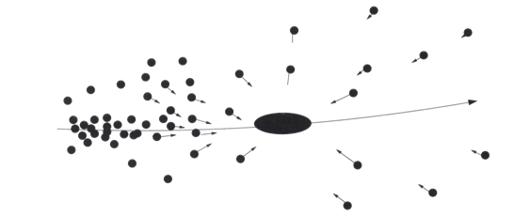
Galaxy clusters - 15
• Dynamical friction
– a massive particle crossing an homogeneous medium does not feel any gravitational force at start
– it attracts other particles → the distribution becomes inhomogeneous
→ accumulation of particles in its wake (behind it)
→ slowing down of the massive particle
→ it migrates towards the cluster center (potential well)
→ accumulation of massive galaxies at the center
– effect even reinforced by merging of galaxies

Slide 28
Galaxy clusters - 16
• Morphological segregation
Proportion of different types of galaxies as a function of environment
Environment | E | S0 | S | (E+S0)/S
Very concentrated cluster | 35% | 45% | 20% | 4.0
Average cluster | 15% | 55% | 30% | 2.3
Low concentration cluster | 15% | 35% | 50% | 1.0
Field | 15% | 25% | 60% | 0.7

Slide 29
Galaxy clusters - 17
Concentration of E and S0 at the center
S in the outskirts
Causes:
– dynamical friction → the most massive at the center
– transition S → S0: loss of gas due to motion in the ICM (intra cluster medium)
– transition S0 → E: `dry´ merging (no gas → no star formation following merging)
– merging S + S → E
– cannibalism: cD (and gE) absorb dwarfs and S

Slide 30
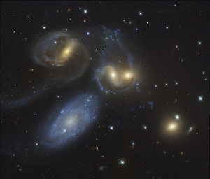
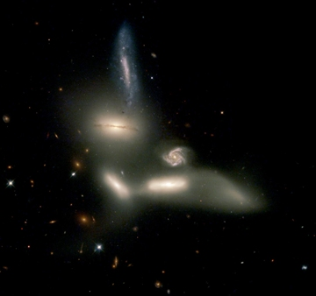
Galaxy clusters - 18
Galaxy groups
• Similar to clusters but less massive, less populated, less extended
• Compact groups:
– a few very close galaxies
– often in interaction
– X emission
– short lifetime (t_{dyn} ~ R/σ ~ 200 million years)
Stefan Quintet
Seyfert Sextet

Slide 31
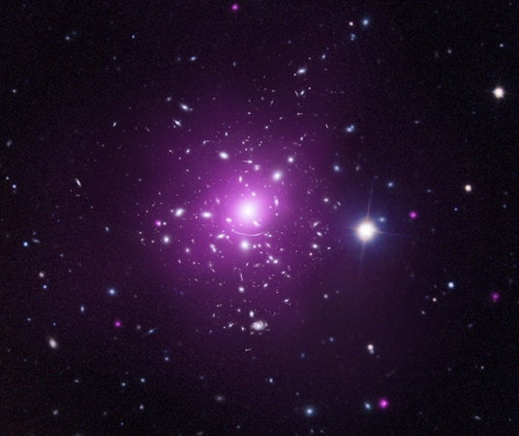
X-rays from clusters
Abell 383 in optical (white-blue) and X-rays (purple)

Slide 32
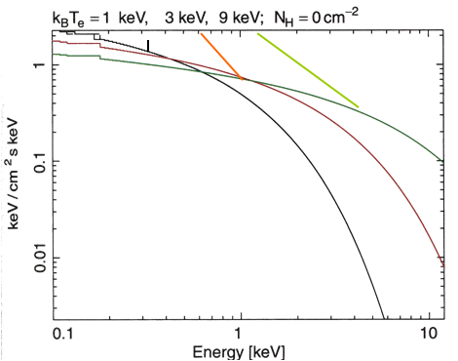
X-rays from clusters – 2
General properties
• extended emission (~ 1 Mpc)
• non variable on the time scale of the observations (30 years)
• luminosity L_{X} ~ 10⁴³ – 10⁴⁵ erg/s
bremsstrahlung radiation (braking) from a hot and diffuse gas:
acceleration of free e– in the electric field of nuclei
• the spectrum shape depends on T → means to determine T
• M_{gas} ~ 10¹⁴ – 10¹⁵ M_{O} ~ 3 – 5 M_{galaxies} (not enough to explain M_{virial})
• T ~ 10⁷ – 10⁸ K (1 – 10 keV)

Slide 33
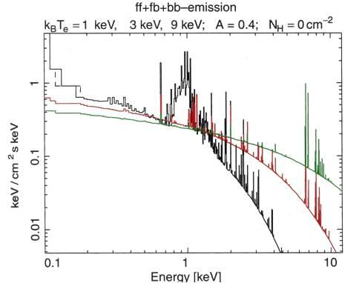
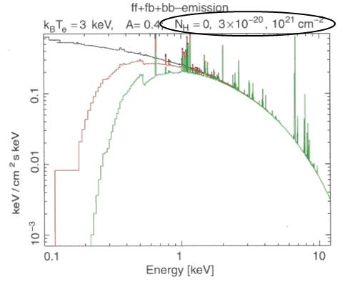
X-rays from clusters – 3
Emission lines
• main line: Lyα from 25 times ionized Fe at ~ 7 keV (Fe nucleus + 1 e⁻ !)
• the hotter the gas (→ ionized), the weaker the spectral lines
• photo absorption at low frequencies, increases with column density N_{H}

Slide 34
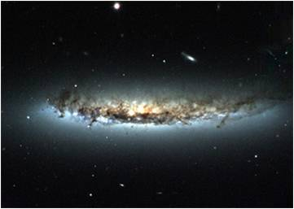
X-rays from clusters – 4
Origin of the hot gas
• presence of metals → gas enriched by nucleosynthesis
→ must come from stars
→ must have been stripped off from galaxies
• causes of stripping:
(1) galactic collisions
(2) motion of galaxies in the ICM
→ `wind´ separating gas and dust from stars

Slide 35
X-rays from clusters – 5
Properties of the hot gas
• temperature: very high (10⁷ – 10⁸ K)
– cluster gravitational potential very strong
→ kinetic energy of particles very high
– secondarily: heating by SNe and AGN
• morphology:
– regular clusters: smooth distribution, centred as the galaxies
– irregular clusters: less smooth distribution, often associated with the galaxies
– frequent departures from axial symmetry → probably no spherical symmetry

Slide 36
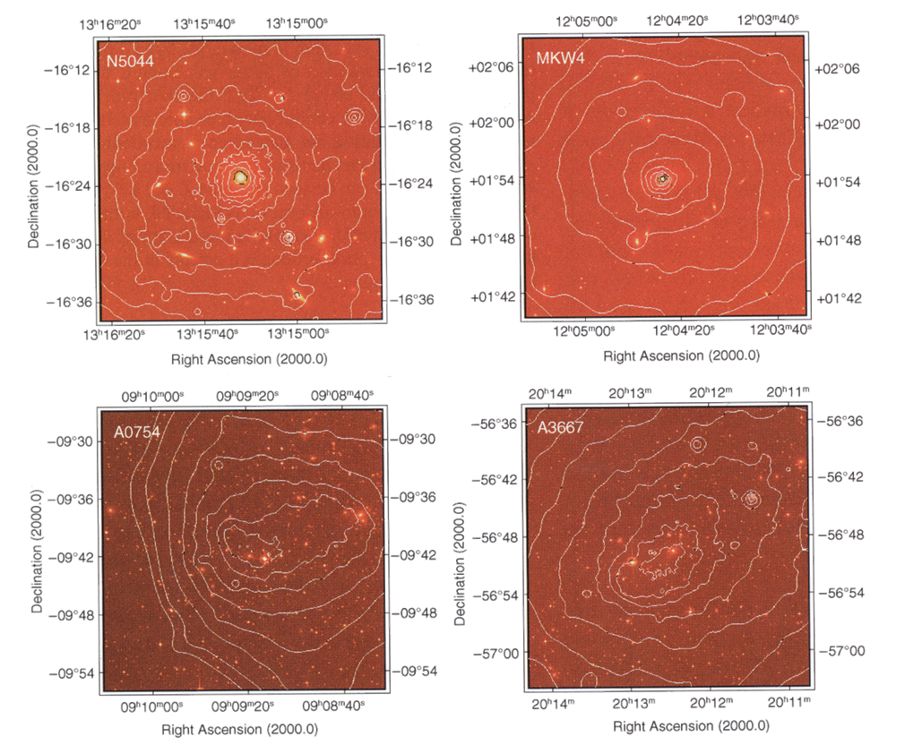
X-rays from clusters – 6
• distribution of X-ray emission in a few clusters:

Slide 37
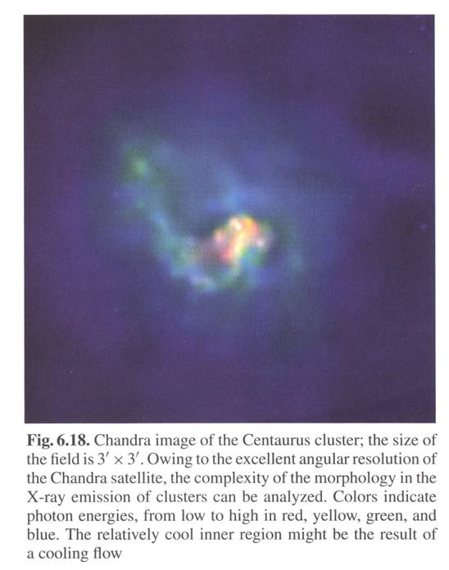
X-rays from clusters – 7
Cooling flows
• X-ray emission takes energy → cools the gas
• slow process except in the cluster center where density is highest
→ pressure decrease in the center
→ the center contracts under the weight of the external parts
→ density increase
→ cooling even stronger
(prediction higher than observed)

Slide 38
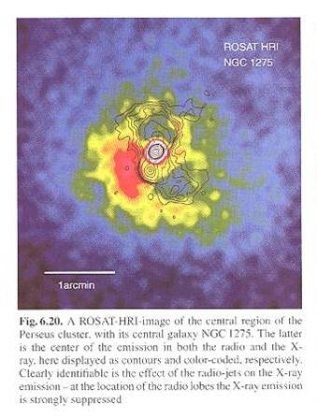
X-rays from clusters – 8
→ there must be an `external´ heating source
• e.g.: AGNs in the cluster center
• radio jets
→ displacement of gas
→ friction
→ heating
Image : superposition of radio (contours) and X (false colors) emissions around NGC 1275, central galaxy of the Perseus cluster; one can notice that the radio jets suppress X emission

Slide 39
Evolution of clusters
• observations of clusters up to z ~ 1 (when the Universe was half its actual age)
→ little evolution of the cluster luminosity function
slight tendency for fewer very luminous and very massive clusters in the past
Butcher – Oemler effect
Variation in the clusters composition
• locally: ellipticals are more numerous in clusters, spirals in the field
• in the past: larger proportion of spirals in clusters
(galaxies evolution + stripping of gas in the ICM)

Slide 40
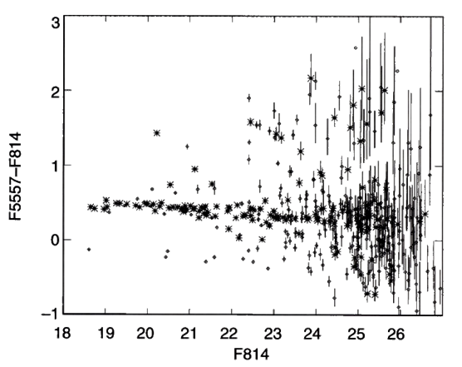
Evolution of clusters - 2
Color-magnitude diagrams (CMD)
• In a single cluster: sequence ± horizontal (→ same color) corresponding to elliptical galaxies (Red Cluster Sequence, RCS)
• Evolution:
– as z increases (younger galaxies), the RCS gets bluer
– so accurate that the RCS color allows to determine z to ± 0.1
– color compatible with age of stars ≈ age of the Universe → most of the stars formed early
– slight slope due to a higher metallicity in more massive galaxies

Slide 41
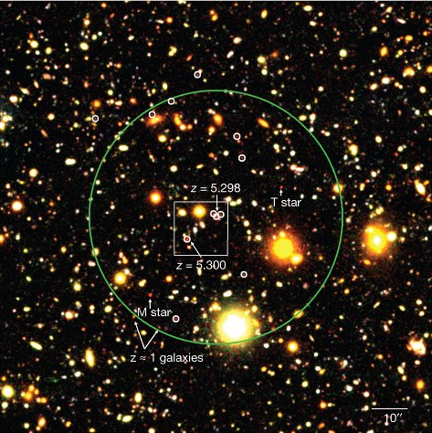
Evolution of clusters - 3
Search for very remote clusters
• search for galaxies around extended X-ray sources (OK for z < 1.4)
• search for galaxies around high redshift quasars (assuming there is a fair chance they lie in clusters)
Image : proto-cluster at z = 5.3 (1 billion years after the Big Bang) discovered around a quasar
Its size is > 13 Mpc and its total mass > 4·10¹¹ M_{O}

