Slide 1
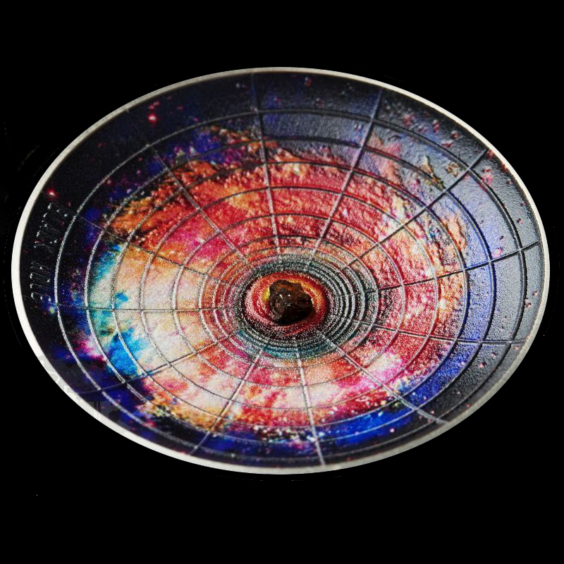
Epilogue
Black Hole Universe

Slide 2
Schwarzschild metric
= metric in vacuum outside a spherical mass distribution
$ds^{2}=\left(1−\frac{r_{s}}{r}\right)c^{2}{dt}^{2}$ $−$ ${\left(1−\frac{r_{s}}{r}\right)}^{−1}$ ${dr}^{2}$ $−$ ${dθ}^{2}$ $−$ $\sin^{2}{θ}$ ${dφ}^{2}$
Schwarzschild radius : r_{s} = $\frac{2GM}{c^{2}}$
metric only valid in vacuum → for r > R (radius of the object)
if R < r_{s} → black hole
2 singularities : r = 0
r = r_{s} (due to choice of coordinates)

Slide 3
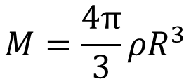
Is the Universe a Black Hole ?
radius of the observable universe : R ~ 4.1× 10²⁶ m
average matter density : $ρ$~ 10^{–27} kg/m³
$$M=\frac{4π}{3}{ρR}^{3}$$
r_{s} = $\frac{2GM}{c^{2}}$ = $\frac{8πG}{3c^{2}}{ρR}^{3}$ ~ 4.3 × 10²⁶ m
→ even if the material universe is not much larger than the observable one, it should be a black hole (BH)

Slide 4
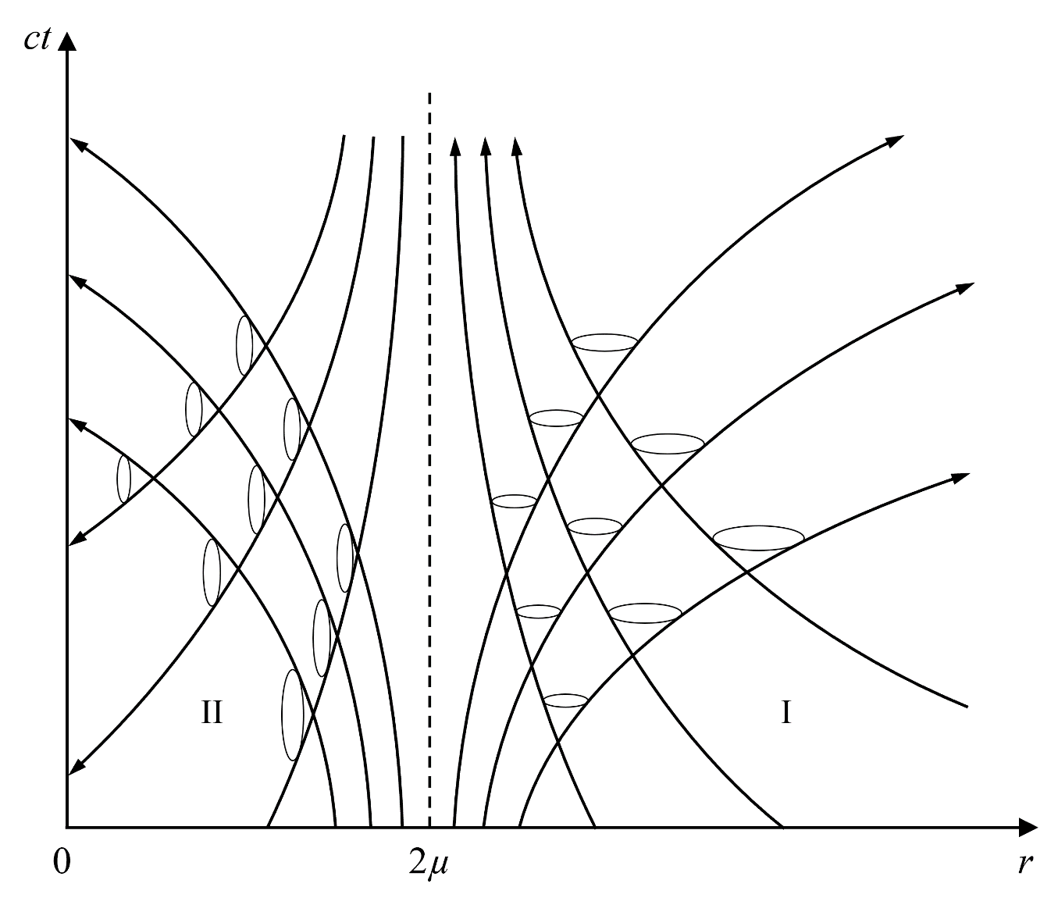
Spacetime diagram of a Black Hole
inside
light cone
outside
light cone
r_{s}
null geodesics around a point source

Slide 5
Schwarzschild metric inside the Black Hole horizon
r < r_{s} → $\left(1−\frac{r_{s}}{r}\right)$ < 0
$ds^{2}=\left(1−\frac{r_{s}}{r}\right)c^{2}{dt}^{2}$ $−$ ${\left(1−\frac{r_{s}}{r}\right)}^{−1}$ ${dr}^{2}$ $−{ dθ}^{2}$ $−$ $\sin^{2}{θ}$ ${dφ}^{2}$
< 0
> 0
→ space-like
→ time-like
→ for an inside observer : t is a space coordinate, r is a time coordinate
→ by renaming r the space coordinate and t the time coordinate :
$ds^{2}={\left(\frac{t_{s}}{t}−1\right)}^{−1}c^{2}{dt}^{2}$ $−$ $\left(\frac{t_{s}}{t}−1\right) {dr}^{2}$ $−{ dθ}^{2}$ $−$ $\sin^{2}{θ}$ ${dφ}^{2}$
(t_{s} = r_{s}/c)

Slide 6
Proper Time
for an inside observer « at rest » (r = c^{t}, Ω = c^{t})
$$dτ^{2}={\left(\frac{t_{s}}{t}−1\right)}^{−1}c^{2}{dt}^{2}$$
$→dτ={±\left(\frac{t_{s}}{t}−1\right)}^{−1/2}$ $c dt$
→ 2 solutions (𝜏 runs in the same direction as t or in the opposite one)
both solutions are mathematically valid in general relativity
which one should we choose ?

Slide 7
Reversed Time
the Schwarzschild criterion indicate we are inside a BH
inside the BH, the roles of r and t are switched
→ the singularity is not a point in space but an instant in time
we observe the universe expanding from an instant in time: the Big Bang
→ the negative solution is the right one
→ the singularity is an instant in our past
the horizon is an instant in our future

Slide 8
What does « Universe » mean ?
how do mainstream cosmologists avoid the conclusion that the universe is a black hole?
« a black hole has to be included in someting
but the universe is everything
→ it cannot be a black hole »
this is an abuse of language confusing different meanings of « universe »

Slide 9
Levels of Universes
Level 1 : everything that exists, whole of spacetime
Level 3 : observable universe
Level 2 : material universe
3 ⸦ 2
2 = 1 or 2 ⸦ 1
mainstream cosmologists force 2 = 1

Slide 10
Reversed Time Black Hole Universe Model
1 (out)
1 (in)
horizon
2
3
FLRW
Schw in
r ↔ t
Schw out

Slide 11
FLRW inside Schwarzschild
modeling a collapsing ball is very complicated
unless it is a ball of uniform density and zero pressure
→ FLRW metric that has to match the Schwarzschild metric at the boundary
not well adapted to stellar BHs but much better to the material universe
it is the same approximation as used in mainstream cosmology
it is a consequence of the cosmological principle in that case
no cosmological principle in RTBH cosmology → just a 1st approximation

Slide 12
Physical processes and boundary conditions
proper time controls the physical processes
→ no difference between standard and RTBH cosmologies there
but : the boundary conditions are different !
standard cosmology : boundary (initial) conditions set at the singularity
→ need an extreme fine-tuning to solve the horizon and flatness problems
RTBH cosmology : boundary conditions set at the start of the collapse
→ no fine-tuning needed, flatness and homogeneity are naturally explained

Slide 13
Flatness problem
in standard cosmology, any departure from flatness increases with time
→ universe needs to be extremely close to flat at the Big Bang
in RTBH, any curvature at the start of the collapse will tend to be washed out
→ if the horizon is far enough in the future, the universe will appear flat
→ flatness problem solved

Slide 14
Horizon problem
solution 1: no limit on the time before the black hole starts to collapse
→ different regions had time to interact
solution 2: r ↔ t inside the horizon
→ what we perceive as a singular time corresponds to a point in outer space
→ the Big Bang should appear the same from all directions
→ horizon problem solved

Slide 15
Particle – antiparticle asymmetry
in standard cosmology, one begins with energy
→ equal numbers of particles and antiparticles are expected
in RTBH, one starts with particles
→ asymmetry problem solved

